Slide 1
Multiple Comparisons

Slide 2
Comparison of a Number of Treatments
The difference between the means of two samples given different treatments can be examined using a t-test. However, experiments often involve more than two treatments and to simply extend the t-test would involve considering all possible pairs of samples in turn.
e.g., 7 treatments would result in 21 t-tests!

Slide 3
Post Hoc Procedures
We have used ANOVA to compare the means from k independent groups. Rejecting the null hypothesis implies that at least one population mean differs but we are still not certain whether all k means differ or if there was just one “odd man out.”
Since comparing means two at a time using separate t-tests with a fixed 0.05 will lead to an unacceptably high probability of making a least one incorrect decision. The solution is to use a post hoc procedure of which there are several available.

Slide 4
Experimentwise error rate
For multiple comparison of means in a designed experiment, the probability of making at least Type I error is called experimentwise error rate

Slide 5
There are many different multiple comparison procedures
Fisher’s Least Significance Difference (LSD)
Bonferroni’s adjustment
Tukey’s multiple comparison
Scheffe’s
Choice of multiple-comparison method depends on the type of experimental design and the comparisons of interest to the researchers.

Slide 6
Tukey developed his procedure for pairwsie comparison when the sample size or the treatments are equal
Bonferroni’s method does not require the condition of equal sample sizes.
Scheffe developed a more general procedure for comparing all possible linear combinations of treatment means (called contrasts.)

Slide 7
Another Method:Fisher’s LSD
If two random samples of size n are selected from a Normal distribution with variance σ², then the variance of the difference between the two sample means is
In the case of ANOVA, we do not know σ², but we can estimate it with s² = MSE

Slide 8
The t-statistic for each 2-sample test may be written as
We can re-write this equation as

Slide 9
If t* is the t-value for a 95% confidence interval with df associated with the MSE, then two means will be considered significantly different at the 0.05 significance level if they differ by more than the value
when both samples contain the same number of entries.

Slide 10
To compare all possible group means using Fisher’s LSD perform the following steps
1) Perform the ANOVA
2) If the ANOVA F-test is not significant, stop.
3) If the ANOVA F-test is significant, then compute the LSD value and if any pair of means differ by more than this value this shows a significant difference.

Slide 11
Brand A | Brand B | Brand C | Brand D
251.2 | 263.2 | 269.7 | 251.6
245.1 | 262.9 | 263.2 | 248.6
248 | 265 | 277.5 | 249.4
251.1 | 254.5 | 267.4 | 242
260.5 | 264.3 | 270.5 | 246.5
250 | 257 | 265.5 | 251.3
253.9 | 262.8 | 270.7 | 261.8
244.6 | 264.4 | 272.9 | 249
254.6 | 260.6 | 275.6 | 247.1
248.8 | 255.9 | 266.5 | 245.9
Mean = 250.78 | Mean = 261.06 | Mean = 269.95 | Mean = 249.32
Std.dev. = 4.7352 | Std.dev. = 3.8661 | Std.dev = 4.5009 | Std. dev=5.2032

Slide 12
The ANOVA table:
Source | DF | SS | MS | F
Treatments | 3 | 2794.3887 | 931.4629 | 43.9886
Error | 36 | 762.303 | 21.1751
Total | 39

Slide 13
H_{o} : No difference between treatment means.
From tables, = 2.8662 @ 5% Using critical value approach as the teat statistic of 43.9886 is greater than 2.8662, we reject the null hypothesis
P-value from StatCrunch = approximately 0
Hence we have evidence of a difference between the population mean distanced traveled of the four brands of golf balls.
BUT WHICH ONE IS DIFFERENT???

Slide 14
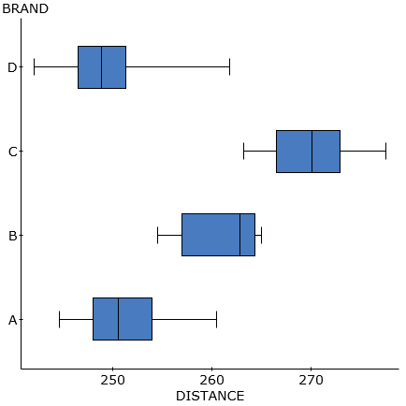
Distribution of Golf Ball Distances (in yards) for Four Brands

Slide 15
Post hoc analysis – by hand
t* df = 36 so that t* = 2.042 at 0.05
LSD =
So two brands means distance traveled differs if there means are more than 4.2022 apart.
Mean A= 250.78
Mean B= 261.06
Mean C= 269.95
Mean D= 249.32
Therefore Brand A is different from B and C
Brand B is different from C and D
Brand C is different from D
Brands A and D are not significantly different

Slide 16
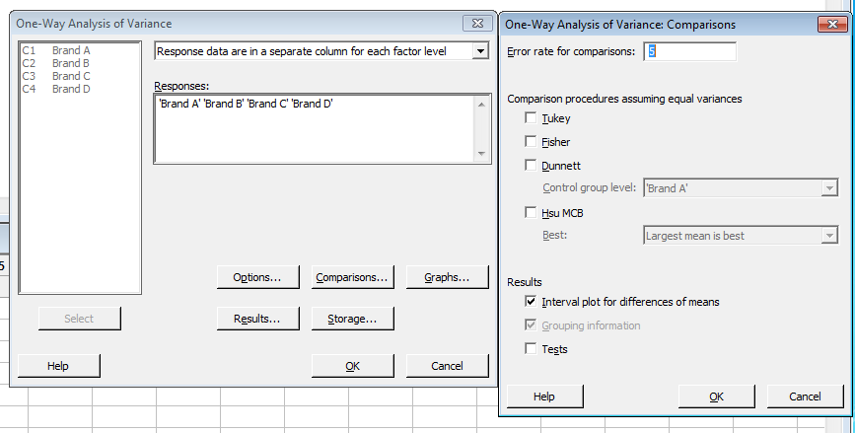
Using Minitab

Slide 17
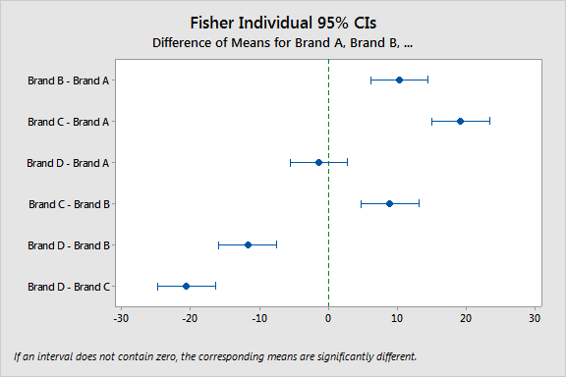

Slide 19
STATCRUNCH OUTPUT Tukey HSD
Tukey HSD results (95% level)
Brand A subtracted from
Difference Lower Upper P-value
Brand B 10.28 4.737573 15.822427 <0.0001
Brand C 19.17 13.627573 24.712427 <0.0001
Brand D -1.46 -7.002427 4.082427 0.8927
Brand B subtracted from
Difference Lower Upper P-value
Brand C 8.89 3.347573 14.432427 0.0007
Brand D -11.74 -17.282427 -6.197573 <0.0001
Brand C subtracted from
Difference Lower Upper P-value
Brand D -20.63 -26.172427 -15.087573 <0.0001

